Slide 1
Project Minigreen
Aaron Hebert
Stephen Lawson
Benjamin Waters

Slide 2
About us
Stephen Lawson
I am a student like everyone else in here
Did not have any programming background prior to this school
Ben Waters
Enjoys back-end programming and machine learning.
Hope to deepen understanding with this project.
Aaron Hebert
Loves his Terminal more than his mother
Wants to earn mad cash with Bachelor's Degree

Slide 3
Proposal
What is the project's purpose?
Finding problems before they become problems.
Making purchasing decisions easier.
What is the problem?
Uncertainty regarding inventory
Amount of goods, when to restock
What our program offers
Ability to view items, history, and future trends
How it will offer its services
Feed in your inventory history
Compile with existing database
Look up results for current and future trends
Who it will appeal to
Small business owners
Uncertain/New business owners

Slide 4
Technical Details
What software will be used to develop it?
Python
Django framework
Use templates to simulate a front-end
MongoDB database
Will it require external resources?
No external resources
Inputs csv/Excel files
Outputs a csv file as necessary

Slide 5
Current Limitations
No access to a real-time inventory system
Inventory remains static until new input imported
Sudden trends (between imports) are unlikely to be caught quickly.
Alerts are only as useful as an observant employee
Accuracy depends on manual input of data

Slide 6
Wireframes

Slide 7
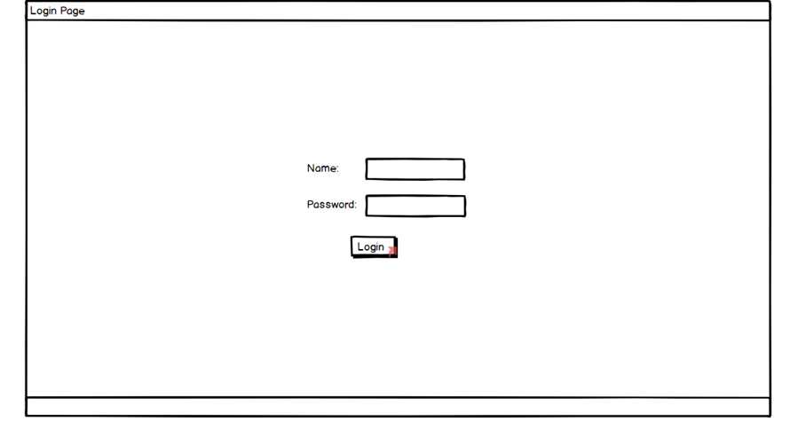
Login Page
Login page
Exactly what it says on the tin
Provides security with a simple interface

Slide 8
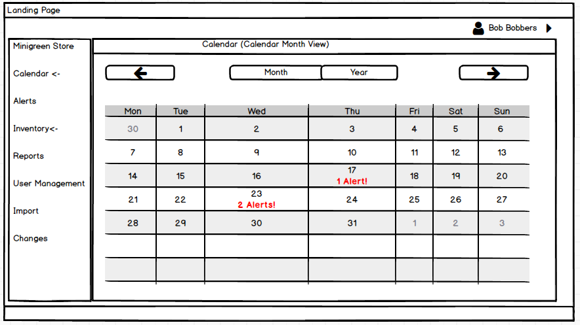
Landing Page
Sidebar grabs attention
Provides easy navigation
Calendar highlights priority items
Both manual and automatic alerts possible

Slide 9
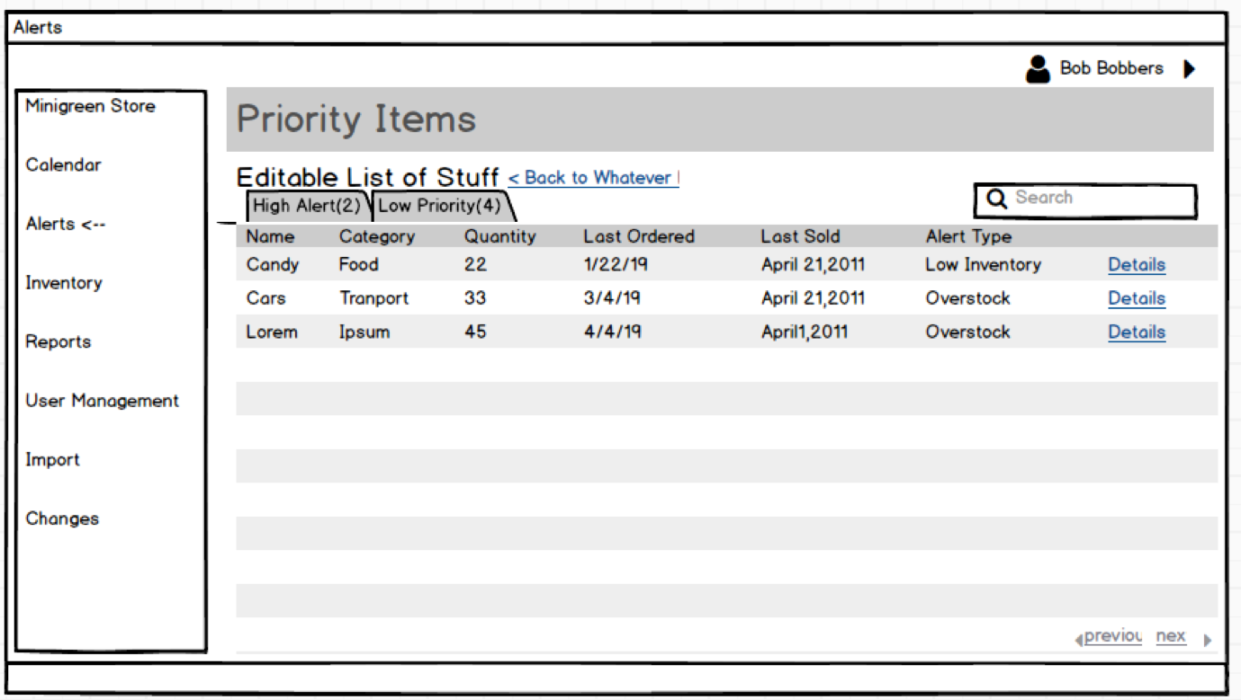
Alerts Page
Details on all alerts
Most recent at the top

Slide 10
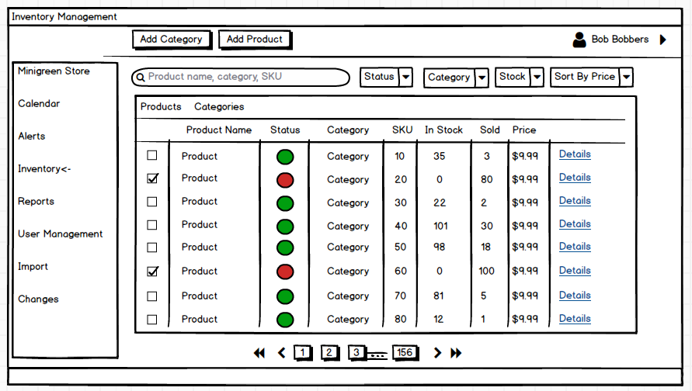
Inventory Page
Inventory Page
Multiple ways to categorize
Colors grab attention
Easy access to item details
Adding and modification
Possible to navigate whole inventory

Slide 11
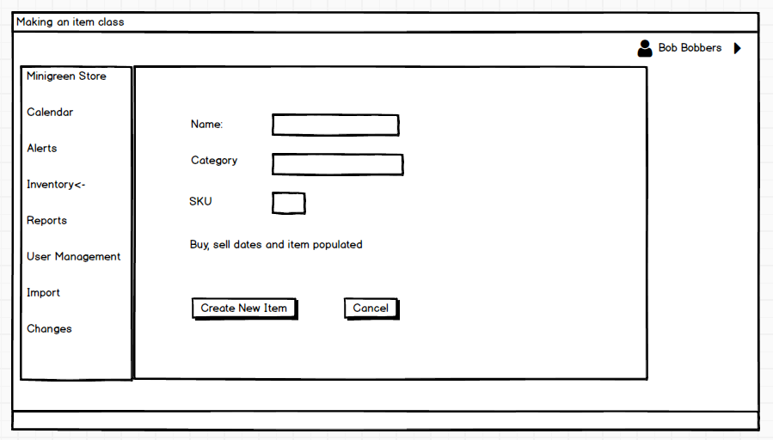
Item Creation Page
Acts as a reference for a future item history

Slide 12
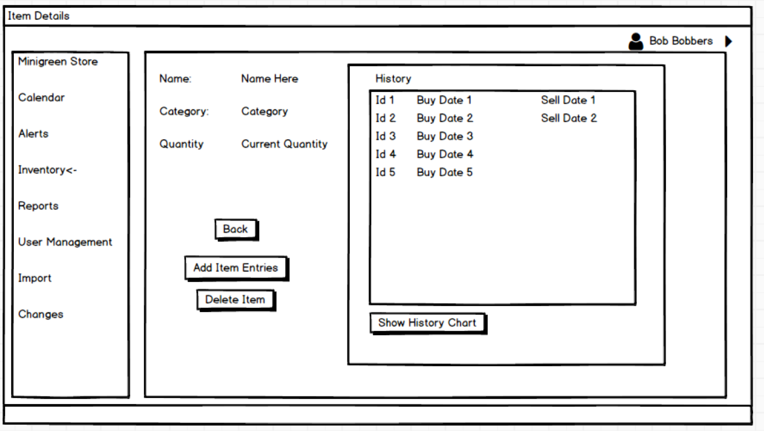
Item Details Page
Displays past and current entries for specific products

Slide 13
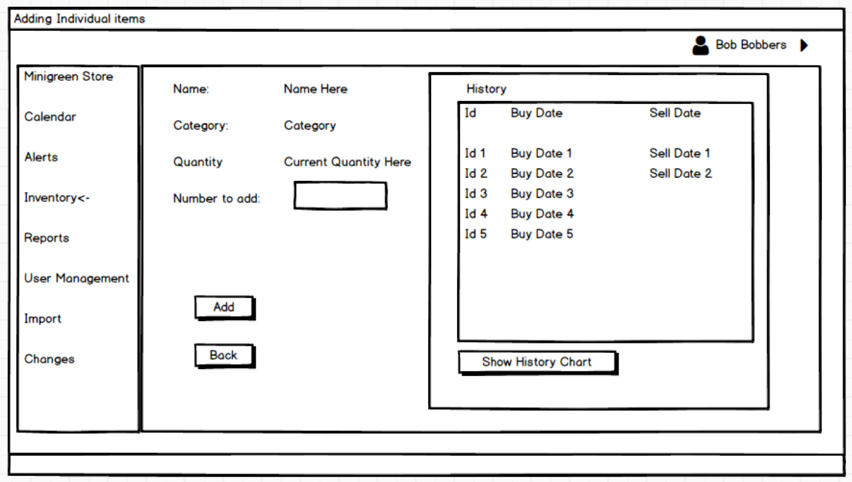
Add Item Page
Adding a new entry to a current product

Slide 14
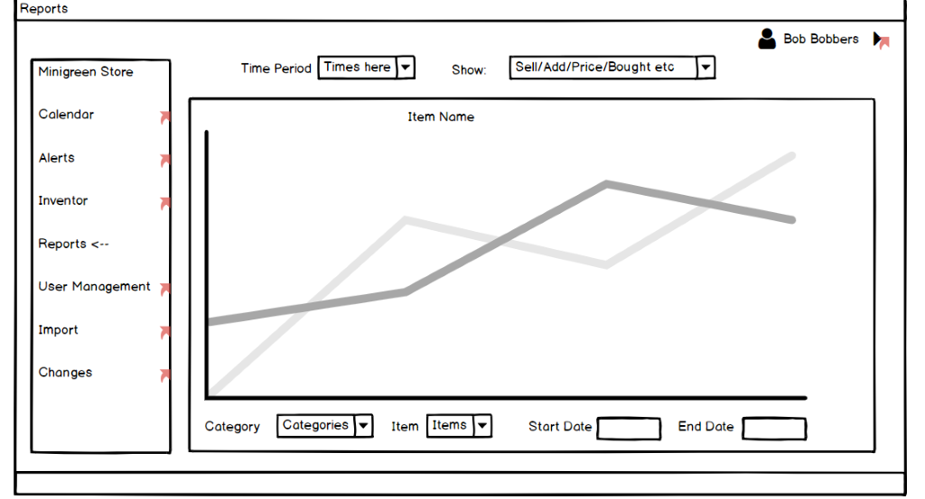
Reports Page
Easiest way to show trends
Any item selectable
Core of the program
Visual representation of trends
Possibly add product comparison

Slide 15
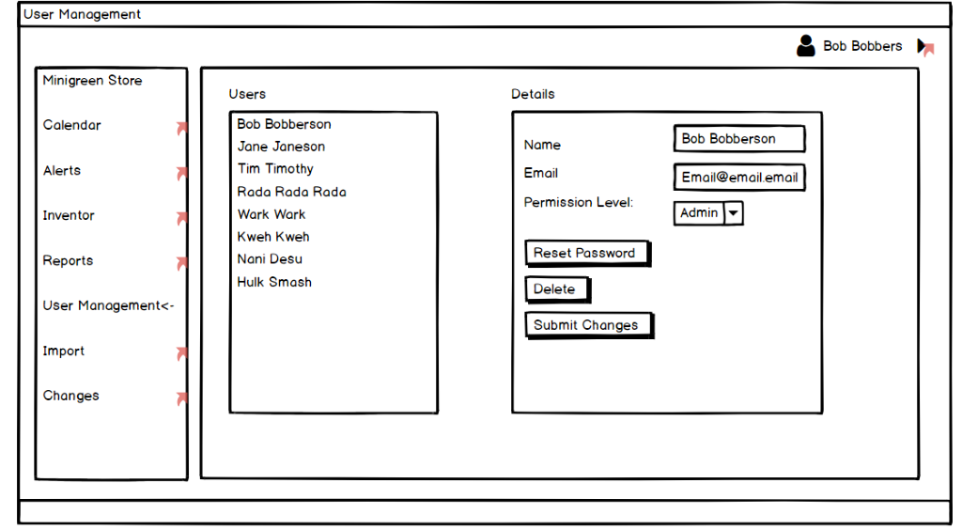
User Management Page
Admins see everyone
Employees only see themselves

Slide 16
User Management Page
Admins see everyone
Employees only see themselves

Slide 17
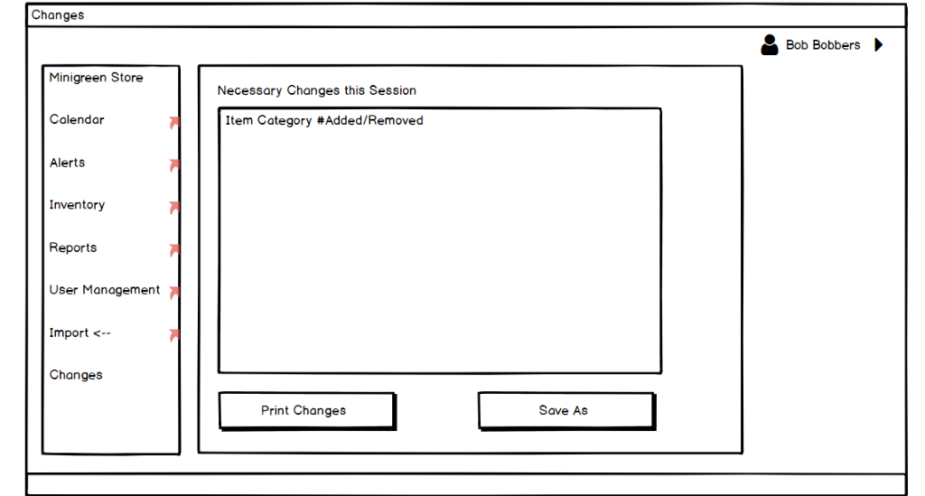
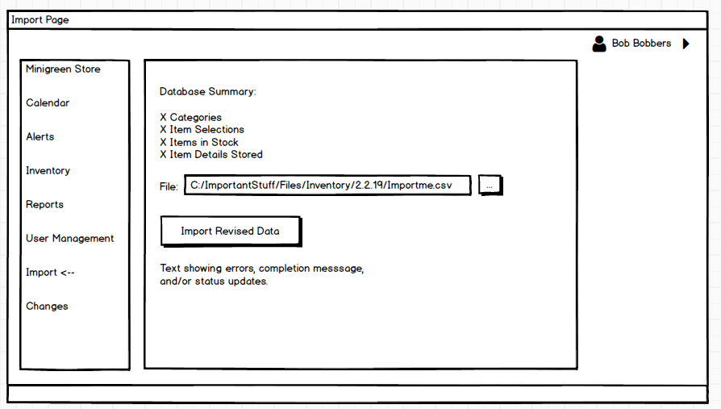
Import/Export Pages
Import Page
Essential component of program
Needs to easily add date
Show errors
Show conflicts
Export Page
Necessary to show needed changes
Works as a confirmation page

Slide 18
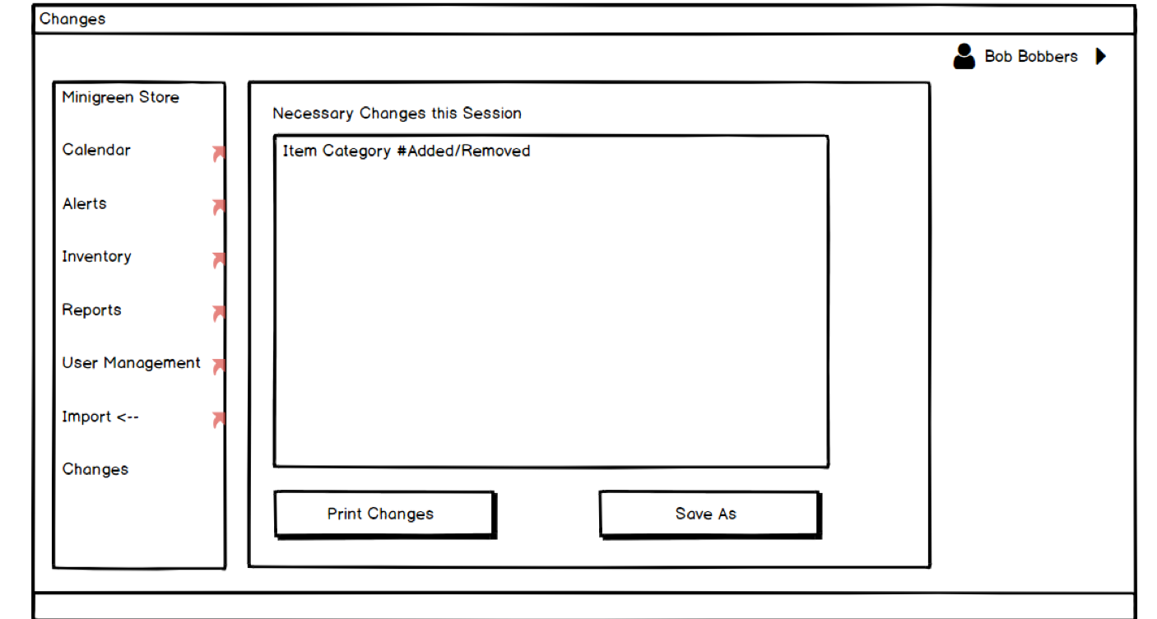
Database Changes Page
Shows changes and errors

Slide 19
User Stories

Slide 20
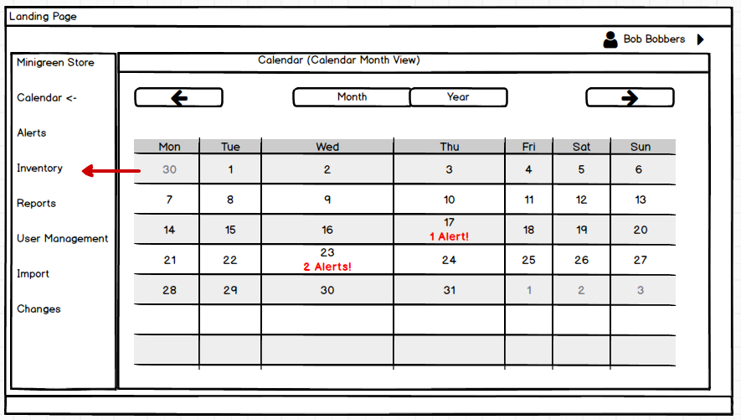
User Stories Checking an item

Slide 21
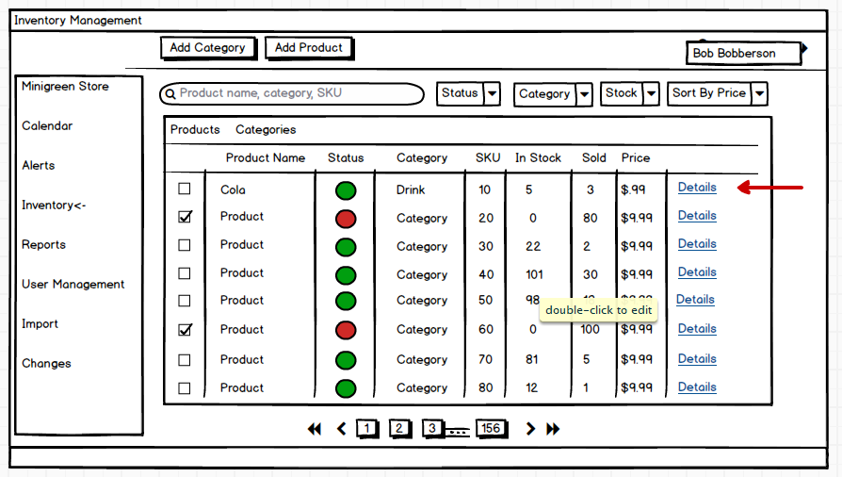
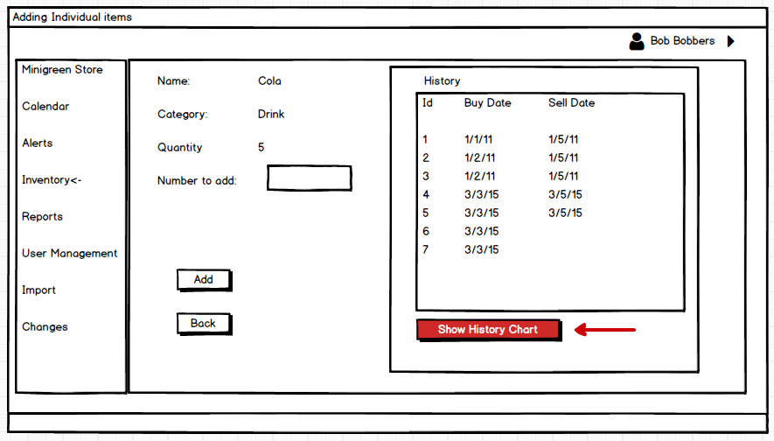
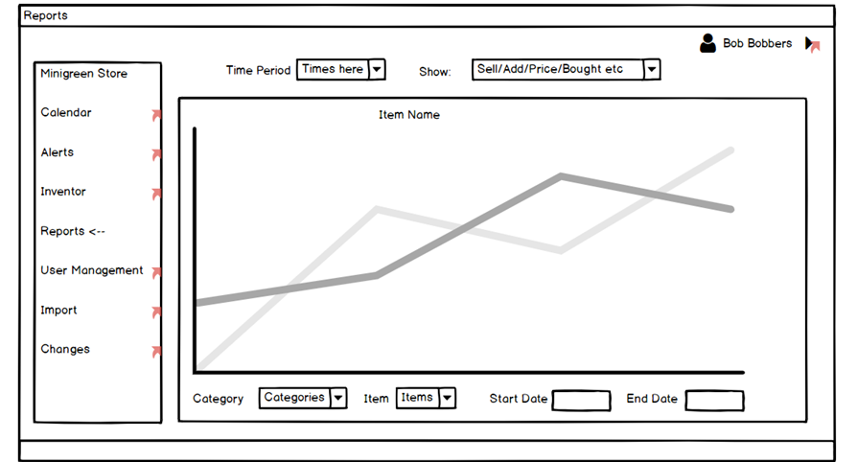
User Stories Checking an item

Slide 22
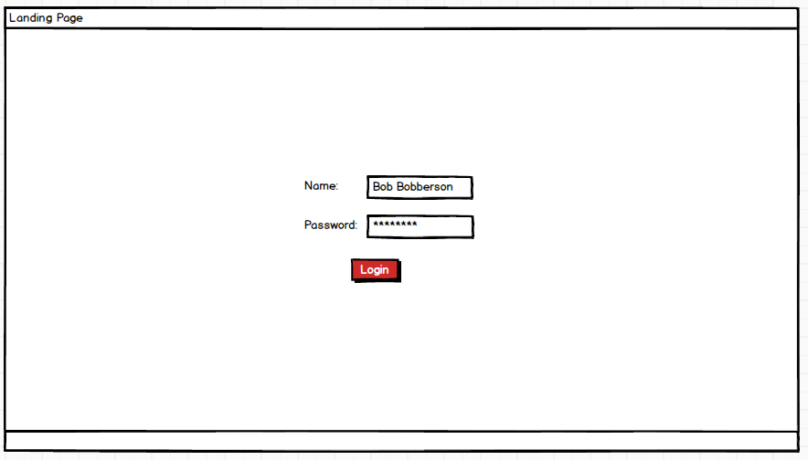
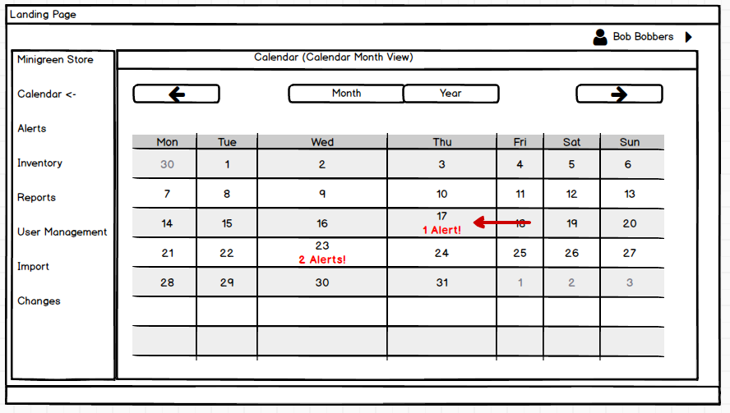
User Stories Checking an alert

Slide 23
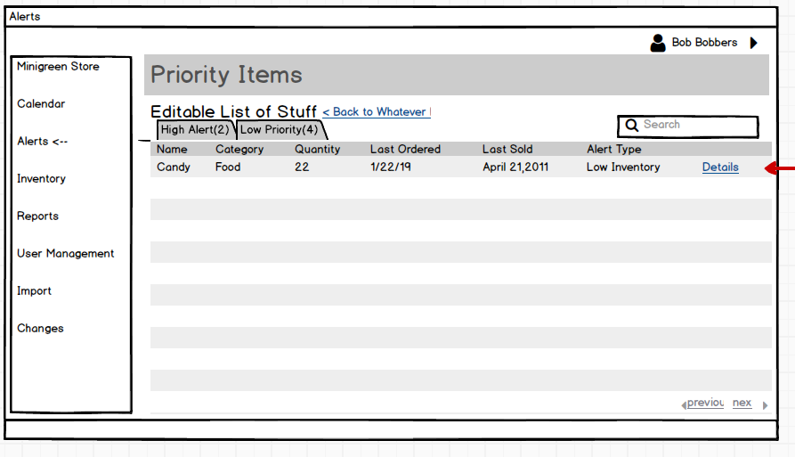
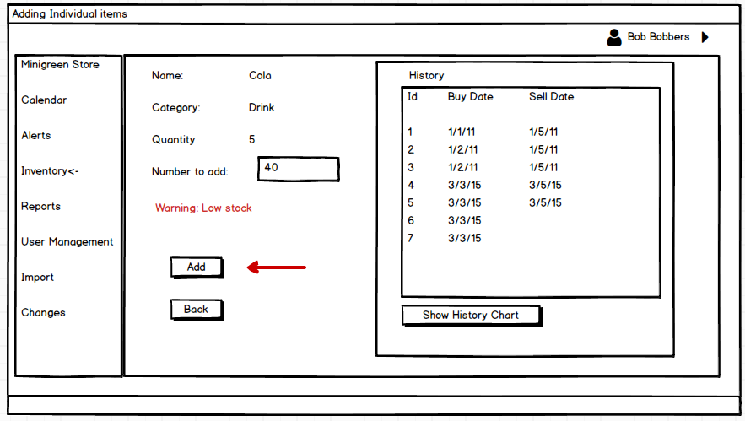
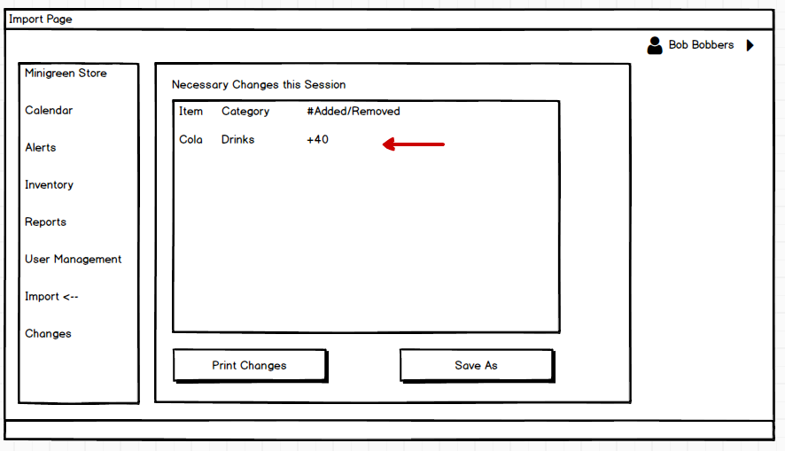
User Stories
Checking an alert

Slide 24
Diagrams

Slide 25
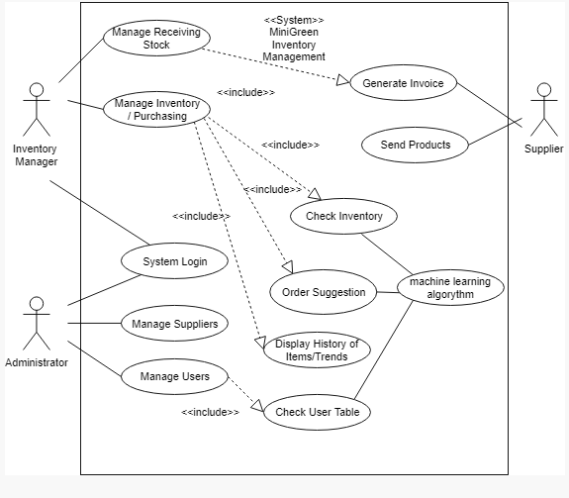
Use Case
Main Actors
Employees
Administrator
Administrator
Set user access
Employee
Manages the Inventory
Supplier
Would receive exported data
Notes:
Usecase
Main actors
Employee
Administrator
Administrator
Sets user access
Employee
Manages the inventory
Supplier
Would get exported data later

Slide 26
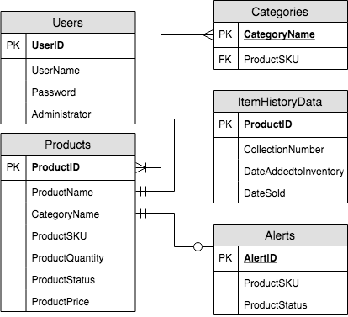
Entity Relationship Diagram
How is information stored?
Users have their own table
Category table for convenience
Products table each product
Items table
Individual items in each product
Much larger than others
Will hold crucial data for analysis

Slide 27
Entity Relationship Diagram
Why each piece of information is relevant?
You need a user table to log in
You need ItemHistoryData to keep track of product history
You need Products to show lists of products
Categories helps in organization
Alerts table points user to necessary action

Slide 28
Entity Relationship Diagram
How each table interacts with others?
Products is most connected
Users is isolated to logins
Only accessed at log and admin access
Item History relates to prediction methods

Slide 29
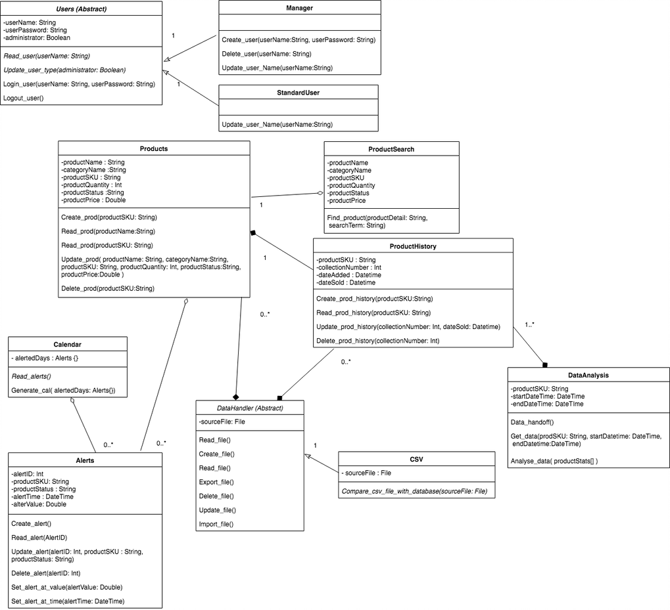
Class Diagrams

Slide 30
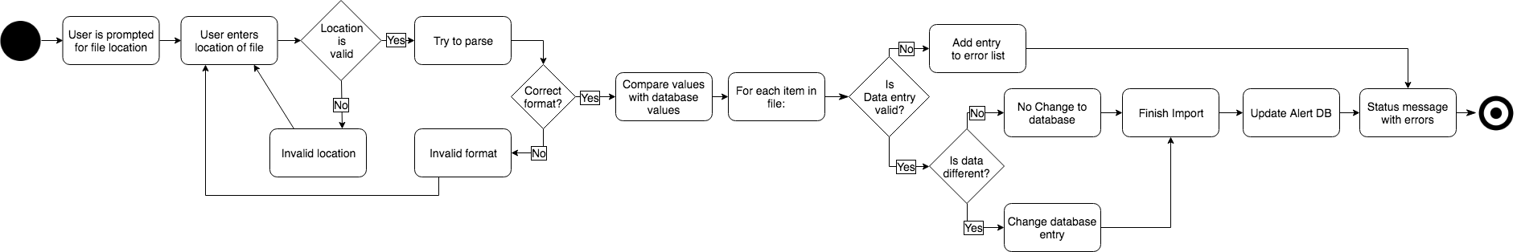
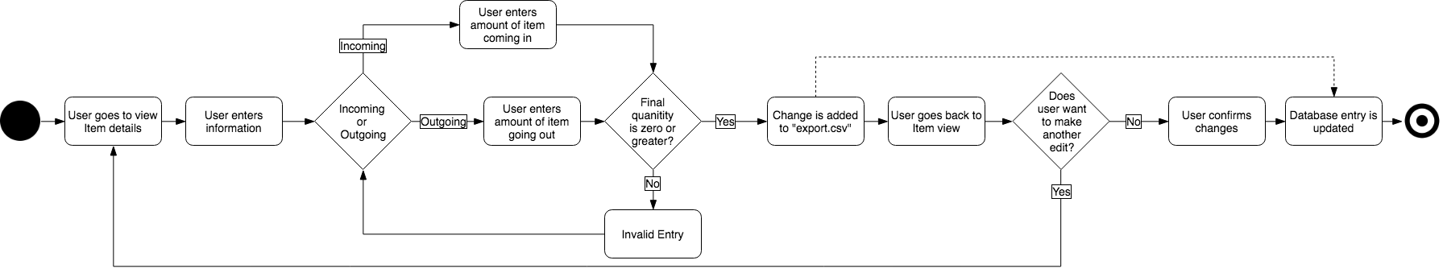
Activity Diagrams
Import Data File
Making an Inventory Change

Slide 31
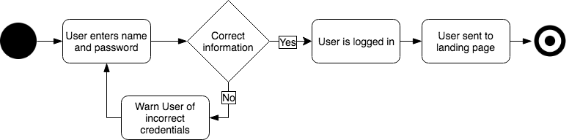
Activity Diagrams
Logging In
Show Histogram

Slide 32
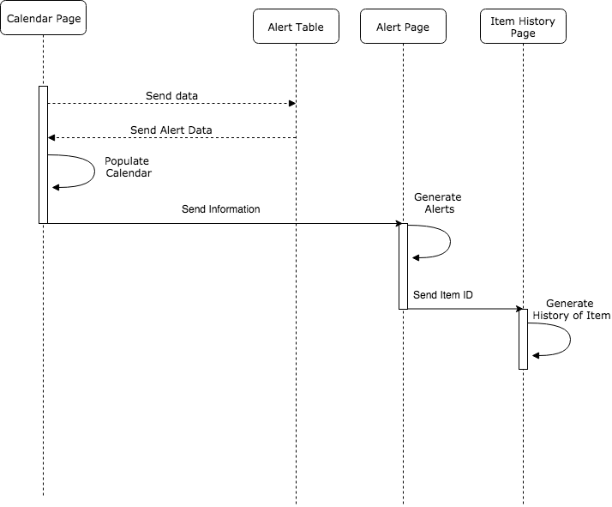
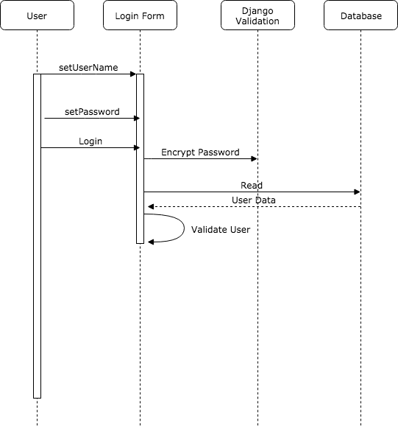
Sequence Diagrams
Alerts
Login

Slide 33
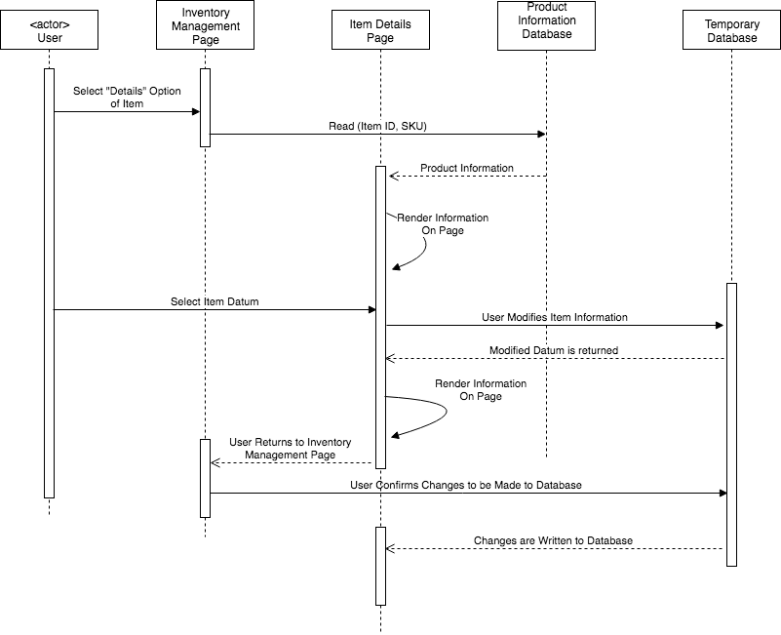
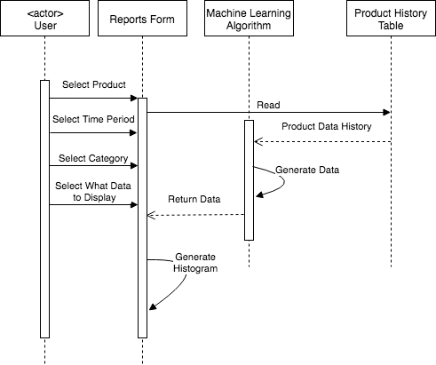
Sequence Diagrams
Modify Product Info
Show Histogram

Slide 34
Gantt chart

Slide 35
Gantt Chart
Developing the Gantt chart has been difficult
Scheduling times
Unknown deadlines
Dividing tasks
It took longer than expected
Studying Machine Learning may take the longest
None of us have done it before
Unsure of how long learning process could take
Could affect end date of task
Very satisfied with current schedule

Slide 36
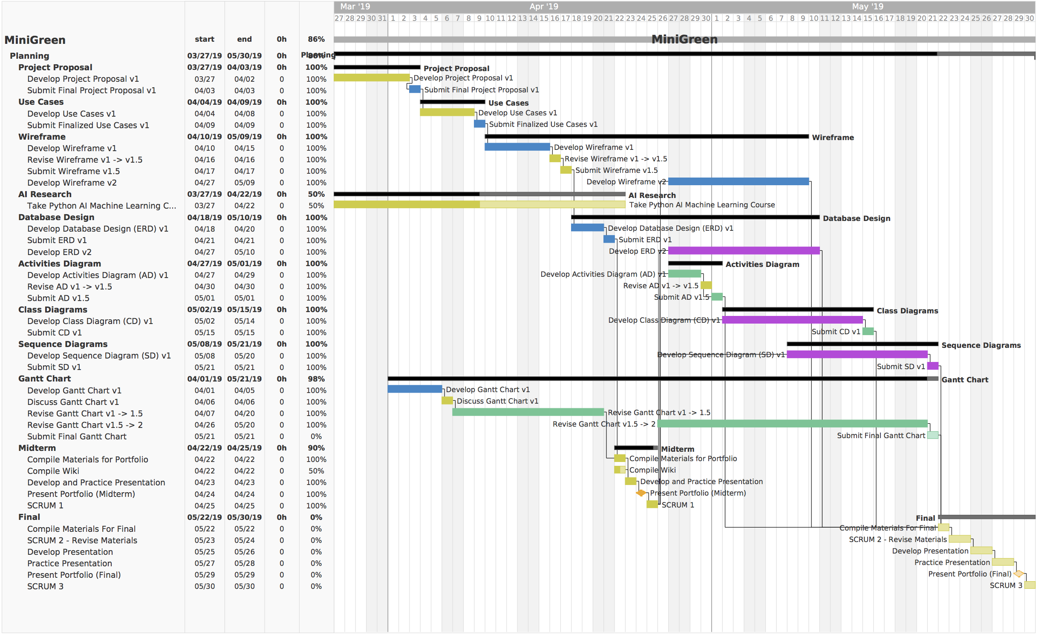

Slide 37
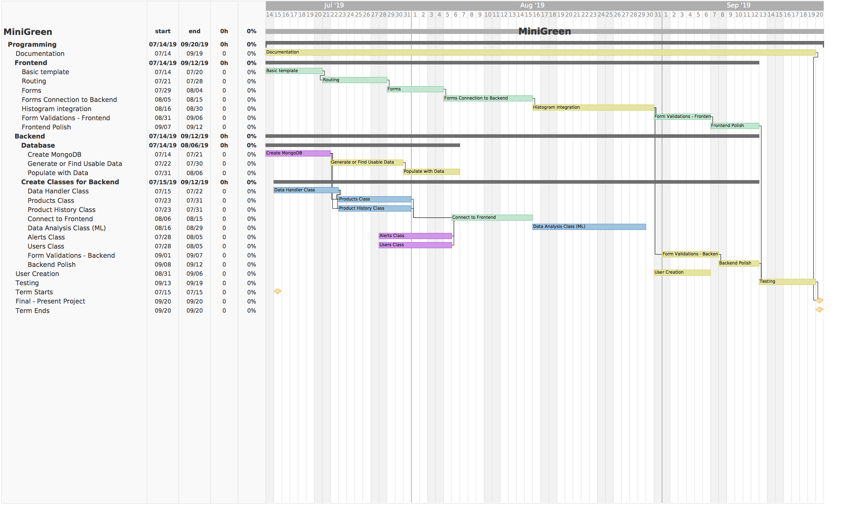

Slide 38
Project Difficulties
What might we not be able to address?
Need to find an efficient way to compare existing inventory with new inputs.
Boils down to efficient search methods.
What are the limitations we face?
The predictive software is only as accurate as your history.
What are some early problems?
Might face difficulties in working with a new framework

Slide 39
In Conclusion
We have the structure of the classes, the tables, and the order of logical operations of the project.
The Gantt Chart provides a solid framework for next quarter's scheduling.
The scope of the inventory can be as large or small, as necessary.
We have a modular site design, which can easily be expanded if necessary.
We are unfamiliar with some aspects of the project, yet research is being done.

